Slide 1
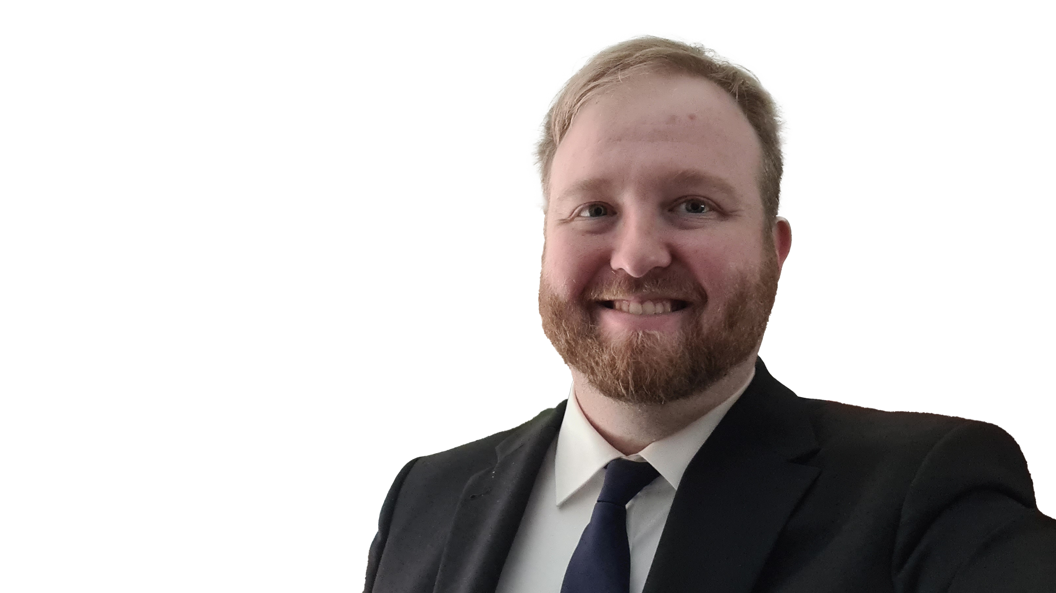
Reinhard Eschlböck
CEO of Eschlböck BIBER Wood Chippers (since 2023)
Responsible for IT, Production, Construction and Development
Degree in mechanical engineering
Studies of business informatics at the Johannes Kepler University in Linz (Austria)
1

